Slide 1
MP UNIVERSITY
THURSDAY OCTOBER 19

Slide 2
Azure Monitor SCOM Managed Instance
Ankur Gupta
Product Manager
Azure Core Management

Slide 3
What is SCOM MI​
A brief

Slide 5
Why SCOM MI​
Customer Value Propositions

Slide 6
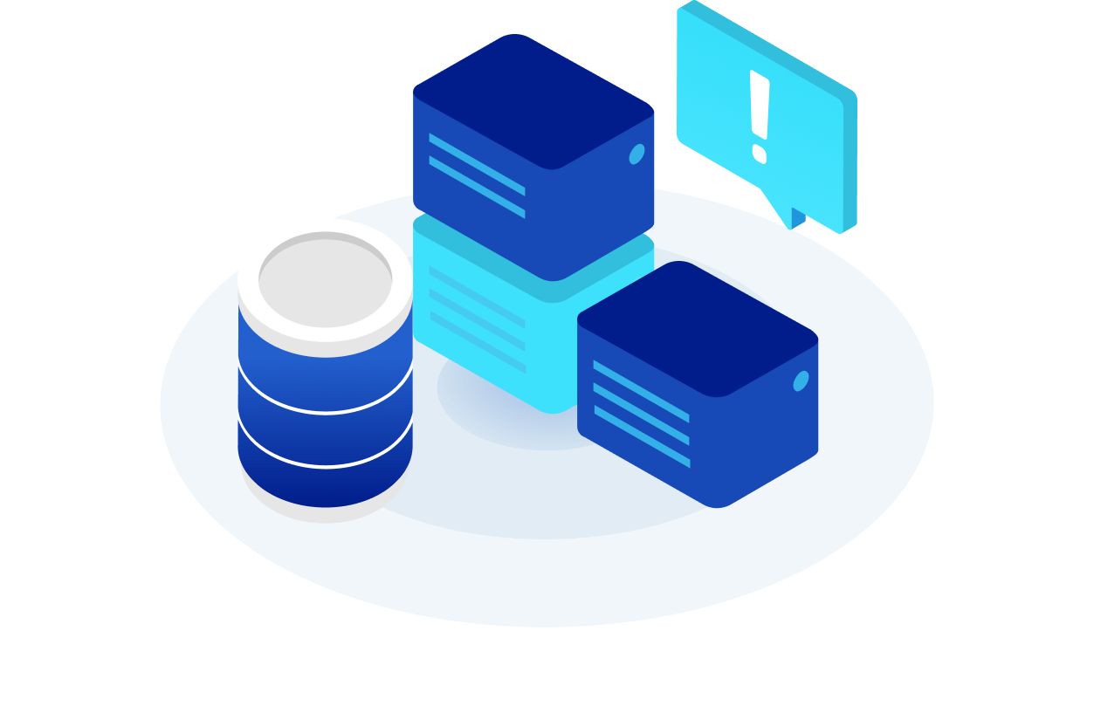
Simplified management of SCOM infrastructure
Preserve SCOM investments in monitoring rules
Consolidated operational experience
The SCOM components created on Azure are Microsoft-managed. No responsibility on customers for hardware updates, scale-up/down, OS & SCOM updates, and maintaining a healthy management group.
All agent based SCOM management packs are compatible with SCOM MI. Configurations and IP made over years are reusable & migratable to SCOM MI.
Observability information from SCOM MI will be integrated with Azure Monitor to provide a single monitoring experience for the estate (infra, platform, and apps on Azure and off-Azure).

Slide 7
Cost savings with SCOM MI​
Customer Value Propositions

Slide 8
Key Benefit: Save upto 30%* of your SCOM costs by migrating to SCOM MI
Component​ | SCOM Today​ | SCOM MI – New Customers​
Compute​ | Customer Managed​ | Azure VMs​ SQL MI (AHUB benefit – discounted rate)​
Environment/Licenses​ | OS Licenses purchased​ SQL Licenses included​ Customer managed updates​ | Charges included with Azure resources​
Monitoring IP​ | System Center SA​ Customer managed updates​ | Benefit for customers(under discussion)​ Pay as You Go pricing : $6/endpoint/month​
Labor ​ | Typical SCOM team size of 3-4 Admins​ | Only 1 Admin is required​

Slide 9
When to use SCOM MI​
The right customer scenario

Slide 10
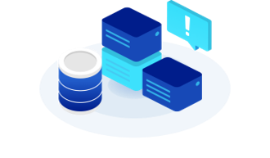
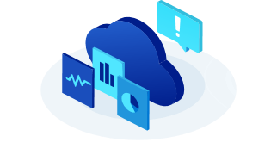
Customers are using SCOM and SCOM MPs to monitor workloads
Migrating On-prem workloads to Azure to have a hybrid environment
Modernize Management and reduce Admin Costs

Slide 11
When to use Azure Monitor instead of SCOM MI​
The right customer scenario

Slide 12
Customers don’t use SCOM today
Customers are modernizing their workloads to SaaS applications in Azure

Slide 13
The future of SCOM MI​
Roadmap

Slide 14
Scenario​ | Features​ | SCOM On-Prem​ | GA (Tentatively November 2023)​
Manageability of monitoring infrastructure​ | Patching​ | Update RollUps (URs) released every 6-7 months and customers have to spend days to update all the SCOM components​ | Auto OS patches​ SCOM patches in a customer defined schedule​
 | Agent management​ | Manually managed by the customer​ | Azure managed through VM extensions​
 | Availability, Reliability, Fault-Tolerance​ | Customer-responsibility. No HA, BCDR promised by the product​ | Instance-level availability & tolerance​
 | Optimization & Scaling​ | Customer-responsibility and infrastructure heavy​ | Manually initiated scale from portal​
Workload Monitoring​ | Reuse of SCOM management packs​ | All agent-based management packs are supported​ | All agent-based management packs are supported​
 | Monitoring non-domain workloads​ | Supported via Gateway servers​ | Via gateway servers for off-Azure endpoints and Via managed identify for Azure endpoints​
 | Monitoring Arc, multi-cloud​ | Arc not supported. Azure MP is there​ | Azure-based, Arc connected and on-prem workloads​
Log collection and analysis​ | Query and analysis of observability data​ | Querying is possible​ | Maintained in SQL MI​ A first-class ability to channel data into log analytics workspace to maintain a central data plane​
Alerting​ | Real time alerts for infra and apps​ | Alerting through SCOM Ops console​ | Integrated alerting with AzMon​
Dashboarding​ | Basic reports about monitoring setup​ | SSRS-based reporting​ | Built-in templates on Azure workbooks and dashboards for Azure Managed Grafana​
 | App specific reports​ | Customers have to manually integrate with SquaredUp​ | Partner published library of dashboards for Azure Managed Grafana​

Slide 15
Appendix

Slide 16
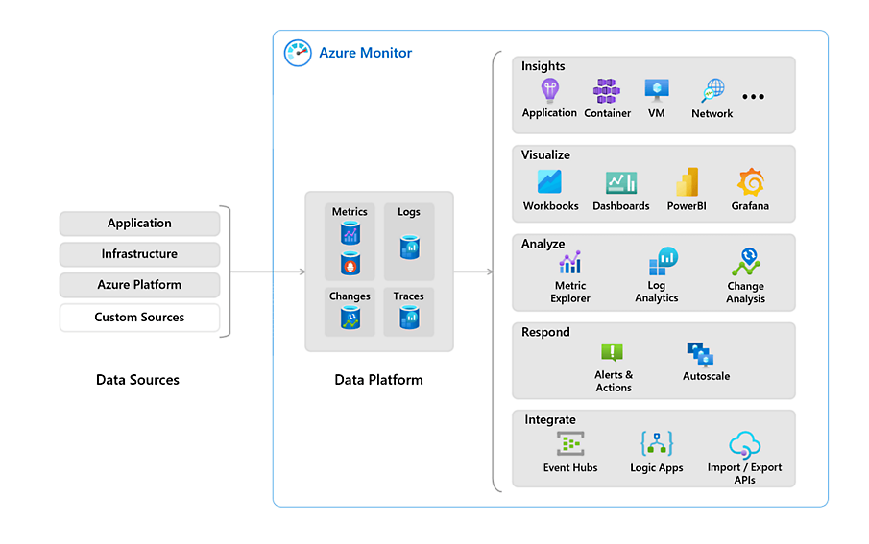
Azure observability and SCOM MI​
SCOM Managed Instance is a capability of Azure Monitor​
Enhancement to Azure Monitor with health models for guest workloads​
Uses existing management packs, the time-tested IP for workload monitoring rules​
A consolidated operational layer for all the observability data​
Respond (Alerts)​
Visualize (Reports)​
Analyze (Log Analytics)​
Integrate (Event hubs)​
SCOM MI

Slide 17
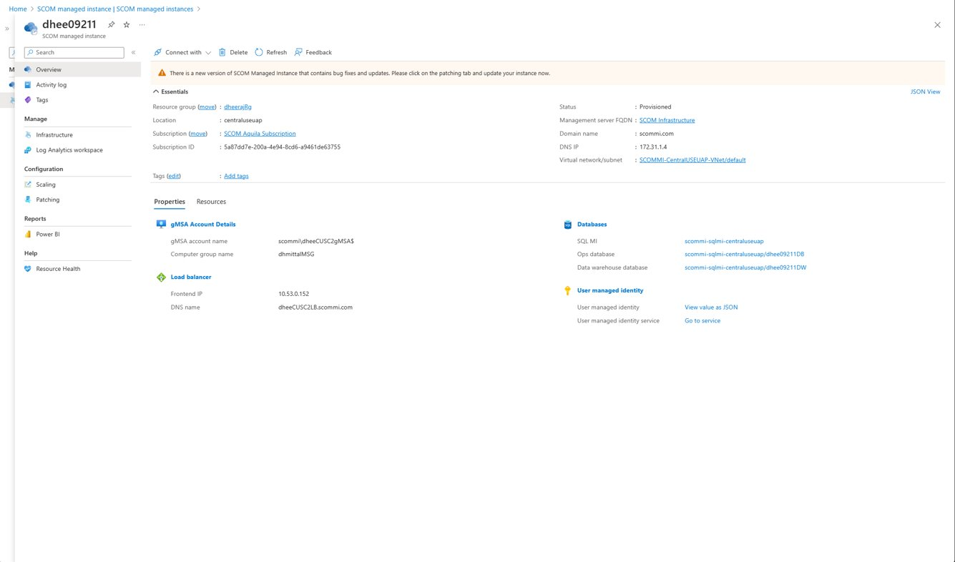
Your very own Control Center on Azure​

Slide 18
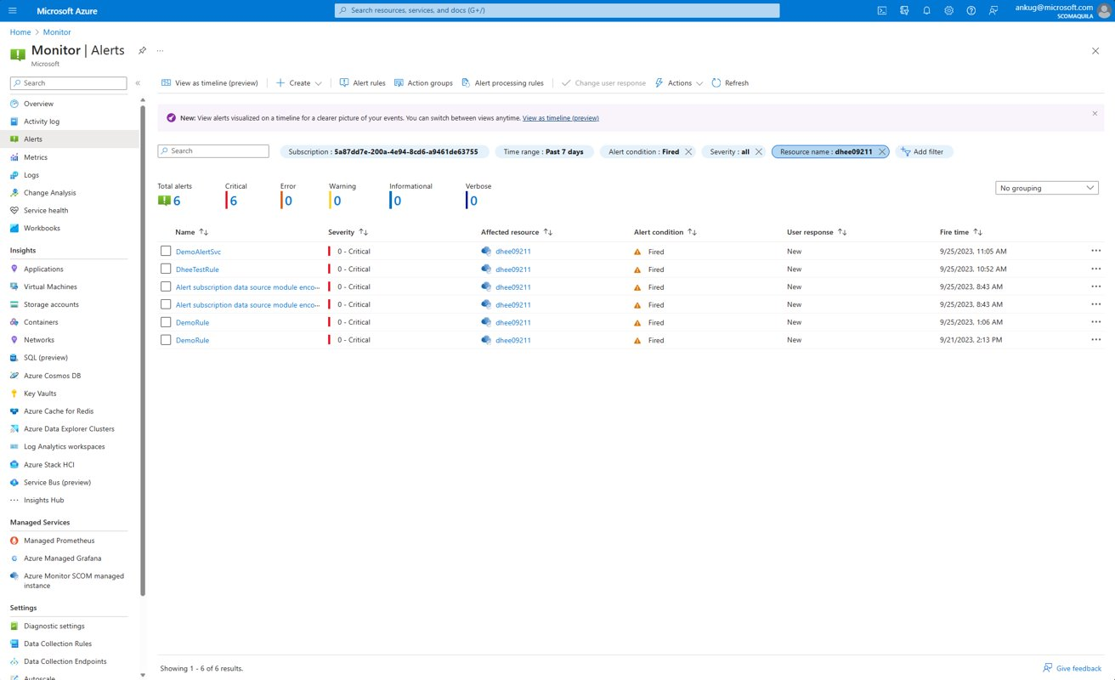
View all your alerts on the Azure Portal​

Slide 19
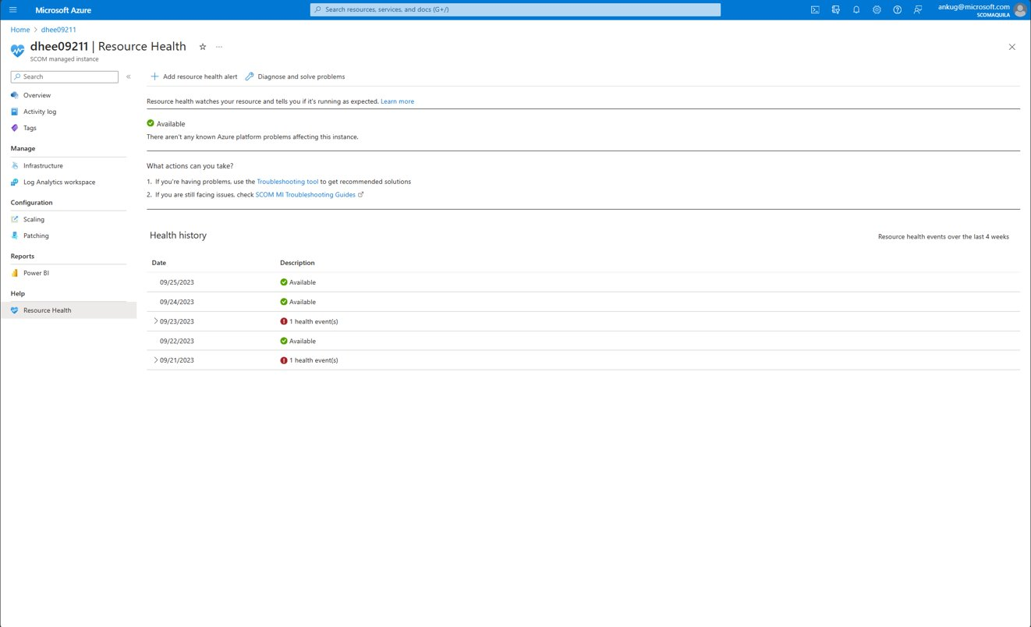
View a summary of your instance health​

Slide 20
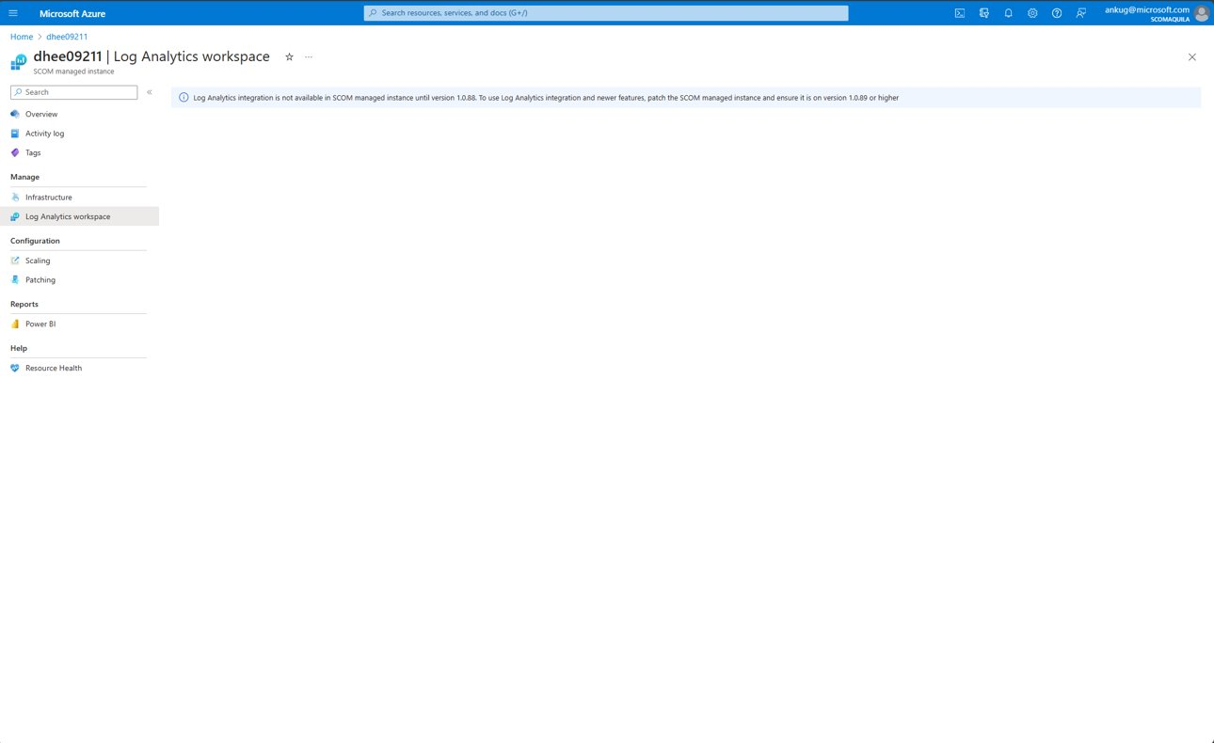
View your SCOM data in Log Analytics​ Control Center on Azure​

Slide 21
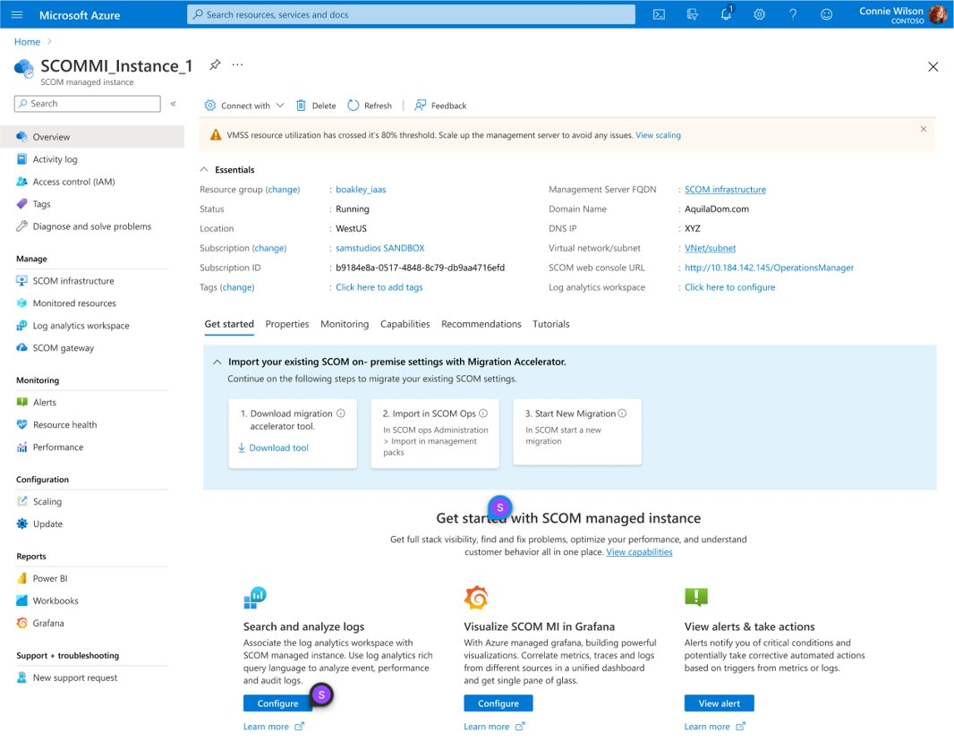
Migrate your existing SCOM on-prem settings with Migration Accelerator​

Slide 22
Your feedback matters!
https://aka.ms/MicrosoftAirliftSurvey

