Slide 1
MP UNIVERSITY
THURSDAY OCTOBER 19

Slide 2
MP UNIVERSITY
SCOM Management Pack Development with ChatGPT and GitHub Copilot
with
Jonas Lenntun
Vincent de Vries
sales@opslogix.com

Slide 3
Speakers
Jonas Lenntun
Vincent de Vries
TECHNICAL BUSINESS DEVELOPER
CHIEF INNOVATION OFFICER

Slide 4
Products & Services Management Packs
VMware Management Pack
Kubernetes Management Pack
Oracle Management Pack
The VMware Management Pack enables the monitoring of the VMware ESXi environment through vCenter™ within Microsoft’s System Center Operations Manager.
The Kubernetes Management Pack monitors the health and performance of your containerized Kubernetes infrastructure.
Proactive monitoring of your Oracle® environment. Monitor all Oracle components (including RAC, ASM, Data Guard and FRA) and tablespace availability.
Capacity Management Pack
SWIFT Management Pack
Ping Management Pack
Generate forecasting reports for all objects within Microsoft’s System Center Operations Manager data warehouse.
The SWIFT Management Pack is a solution that enables the monitoring of the SWIFT Gateway™ and SWIFT Alliance Access™ servers within Microsoft’s System Center Operations Manager.
The Ping Management Pack checks the status of your environment by means of ICMP Ping in Microsoft’s System Center Operations Manager.

Slide 5
Products & Services Other products
Oracle Management Pack
EZalert
Oracle Log Analytics
ServiceNow Incident Connector
SCOM Connector for MS Teams
Optimize your IT Operations using a virtual operator that automatically filters out alert noise and removes manual dispatching routines inside Operations Manager.
Use the OpsLogix Microsoft OMS Log Analytics Solution to monitor your Oracle Environment.
With the ServiceNow Incident Connector you get bi-directional data sync between SCOM alerts and ServiceNow incidents.
The SCOM Connector for MS Teams allows you to get bi-directional data sync between SCOM alerts and MS Teams.

Slide 6
Products & Services Services
Monitoring as a Service
We have gathered our experience, combined knowledge, and software, including how we deliver monitoring, under a single umbrella.
In practice – what is included in the service?
For example…
Lifecycle management
Upgrading to new versions of SCOM
New development of solutions and Management Packs
Continuous testing of the IT environment
Configuration of performance
Troubleshooting.
Build
1
2
Monitor
Improve
We are here for you during the entire process
Support
Order new monitoring
Monthly meetings.
3
We build and implement a monitoring solution according to your requirements and set of programs and applications integrated into SCOM.
Throughout the lifecycle of the service, we are present with support and as a long-term knowledge partner - to build great monitoring capabilities.
Rely on monitoring that is constantly developing, improving, and staying relevant and future-proof with little effort required from you.

Slide 7
Agenda
Introduction
The Power ChatGPT and Github Copilot
Visual Studio / Visual Studio Code
User Story
Developing the solution
Summary
Q&A
Notes:
Conclusion

Slide 8
Introduction
The Benefits of using ChatGPT & Copilot
in the Opslogix delivery
Exploring new opportunities
Practical use-cases
Key findings and insights

Slide 9
The Power of ChatGPT and GitHub Copilot
Natural Language processing
Prompt Engineering
Remember, the same prompt can return different results
Use case: Requirement specification
How we us it internally at Opslogix
Overall benefits

Slide 10
How to get started Visual Studio & Visual Studio Code
Demo

Slide 11
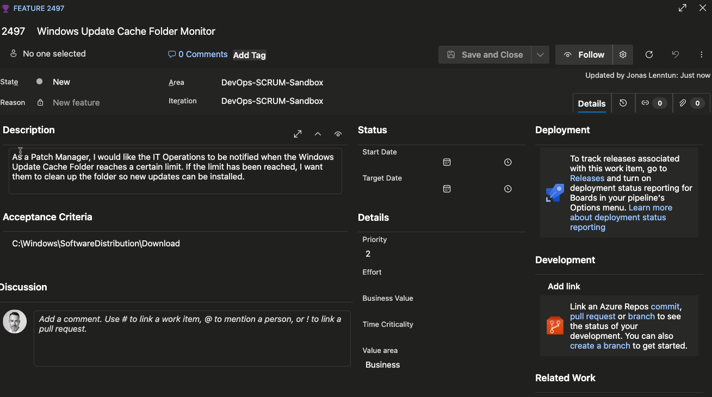
User Story
As a Windows Server Administrator working in Operations, I would like IT Operations to be notified when the Windows Update Cache Folder (C:\Windows\SoftwareDistribution\Download)
reaches a certain limit.
If the limit has been reached, I want them to be able to clean up the folder so new updates can be installed.

Slide 12
Develop the solution
Overview
SCOM Management Pack Authoring perspective
Think beyond the specific user story
Reuse the code an make the solution slim but dynamic
So let us begin with the core of the solution - the script. Let's ask ChatGPT and give it some context.

Slide 13
Developing the solution The script
I want you to act as a Powershell Developer. I want you to create a Powershell function that executes locally on a Windows Server 2012 and above.
The function should retrieve the size of the specific “folder C:\Windows\SoftwareDistribution\Download" and return a string value of "warning" if it is above 10240MB and a string value of "Critical" if above "20480", otherwise it should return "Ok". These thresholds should be input parameters to the script as well and the current size should be returned in the output.
I want you to add error handling to the script as well as a timer function and return both the error and the execution time in the output as separate properties. If an error is thrown, the return code of the script should be Critical.
As the folder could potentially be in a different place on the server I would like to add the folder path as an input parameter to the script.

Slide 14
ChatGPT Script Workflow
Demo

Slide 15
Developing the solution The Management Pack
Act as a SCOM management pack developer.
I want you to create a management pack
named Digital Operations Windows Server FolderObserver with the ID and Namespace Digital.Operations.Windows.Server.FolderObserver. The Management Pack should be created for
SCOM 2016 and later. I dont want any rules, monitors or discoveries.

Slide 16
ChatGPT Management Pack Workflow
Demo

Slide 17
Working with GitHub Copilot Visual Studio 2022
Demo

Slide 18
Summary
Perfect use when creating a user story
Better instructions gives you better results
Great tools to use as a complement to your workflow
You still need to understand how to author MPs
Probably better to start with (Silect, fragments, snippets)

Slide 19
Q&A What are your thoughts?

Slide 20
Thank you!
www.opslogix.com
sales@opslogix.com

