Slide 1
MP UNIVERSITY
THURSDAY OCTOBER 19
Notes:
Welcome to another session at the MP University today!

Slide 2
Inside SCOM Managed Instance
MP UNIVERSITY 2023
Bob Cornelissen, TopQore, MVP
Notes:
My topic for today is going to be an Azure Monitor SCOM Managed Instance. Now, Ankur did a session about SCOM MI earlier with a focus on the vision, relation to a fictive case at Pineapple and what can currently be said about the release date and features and costs.
I will therefore be keeping the story of why we can use SCOM MI short in the following slides and next jump to the technical bits for basic design and components and some insights into the newer features in the current Preview releases.

Slide 3
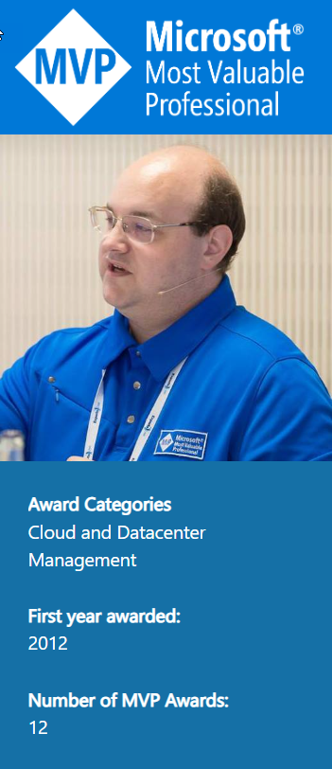
Bob Cornelissen
MOM/SCOM since 2002
12-year Microsoft MVP
Technical Director
Hobby: Carom Billiards
“House of Tails” charity ambassador
Notes:
This is a bit about me, Bob Cornelissen from the Netherlands. I have been working with MOM and SCOM since 2002. Many people think I only work with SCOM, but I did actually come from the Windows Server infrastructure side, with domain services, networking, Exchange, security, and manageability. I am currently also involved in cloud and hybrid cloud and management strategies. Now a 12-year MVP for Cloud and Datacenter management. I am the technical director for TopQore and a few related companies. I love to play carom billiards as a form of relaxation away from a computer screen. And I am a charity ambassador for House of Tails, which is a charity taking care of around 70 street dogs with unfortunate pasts in two locations in Thailand.
Let's quickly jump to the topic.

Slide 4
SCOM is great!
Good for monitoring Microsoft server-based workloads, Operating Systems, Apps, Infra, etc.
However,…
Notes:
I have been working with SCOM for over 20 years, and I stand by the statement at the top there. SCOM is great for monitoring all kinds of Microsoft server-based workloads, operating systems, applications, and infrastructure, and it has so much flexibility that you can make it do whatever you need it to do. However, many companies are in some kind of cloud transition. This might be anything from having a few applications hosted in web apps, to running entire datacenters and apps in a cloud platform in for example Azure. When doing a cloud transition, there are a lot of things to think about, and monitoring is one of those. We want to retain our observability.

Slide 5
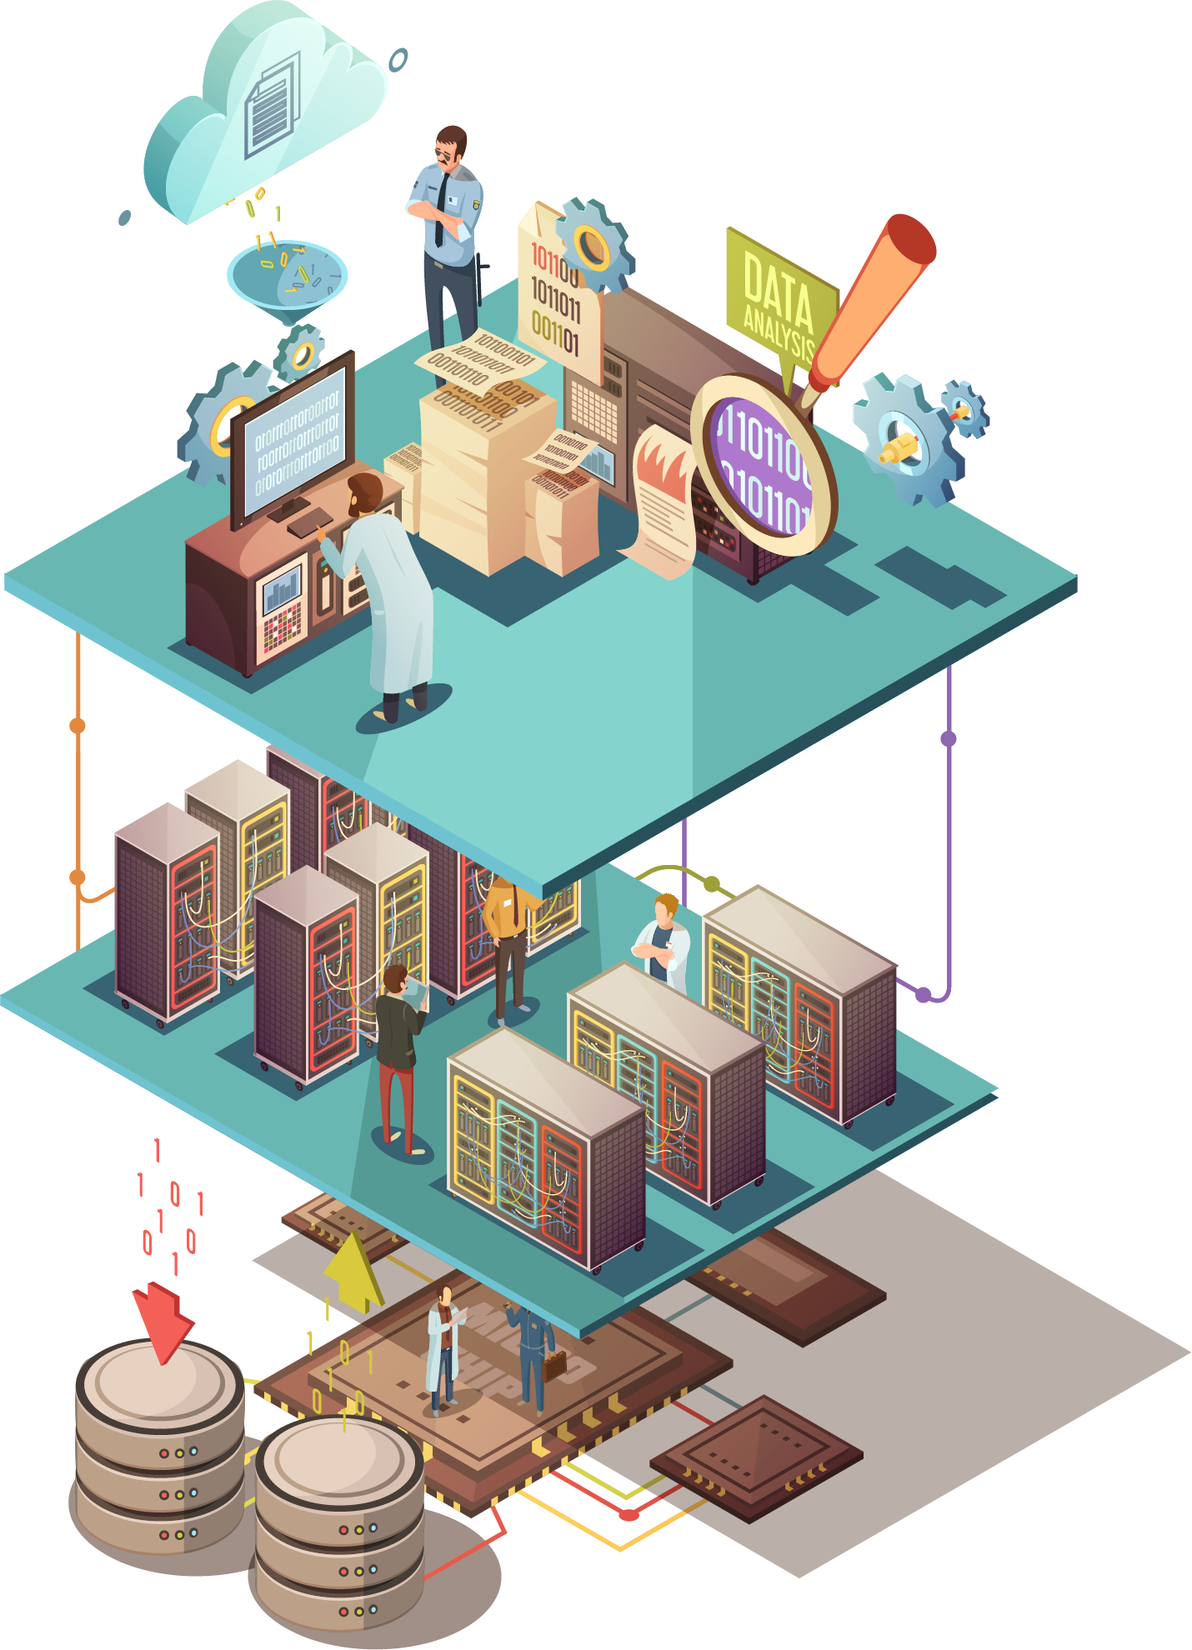
What’s the problem?
It lives in your datacenter (CapEx and OpEx costs)
Has a large footprint (CPU, Mem, Disk)
Needs maintenance (updates Win, SQL, SCOM)
Needs knowledge to setup backend (Design, Install, Configure)
Notes:
So, what is the problem? Well, it depends on if you see things as problems or small points of attention and every case is different. However, when looking at cloud transition and combining it with SCOM in your own datacenter, we land on some items of interest. *
SCOM lives in your datacenter. There it incurs both capital expenditure and operational costs. *
SCOM is an application that needs a relatively large footprint in processor capacity, memory and disk space. *
It needs regular maintenance, such as running monthly Windows updates, quarterly for SQL and once or twice a year for SCOM update rollups. *
And it needs knowledge to setup the backend through designs, installation, configuration and so forth. Something I have been asked to do for many customers.

Slide 6
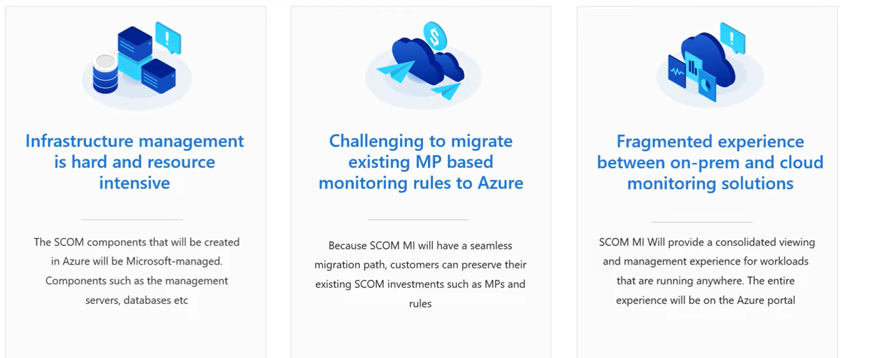
Why SCOM in the Cloud?
Notes:
All right, so Ankur talked about these kinds of points before. Running SCOM in the cloud through SCOM MI is supposed to make running the infrastructure pieces easier. You do not need to instantly try and re-create whatever SCOM can do into Azure Monitor and start from scratch. An important item during cloud transition and running a hybrid cloud is to get a consolidated view into your IT backend.

Slide 7
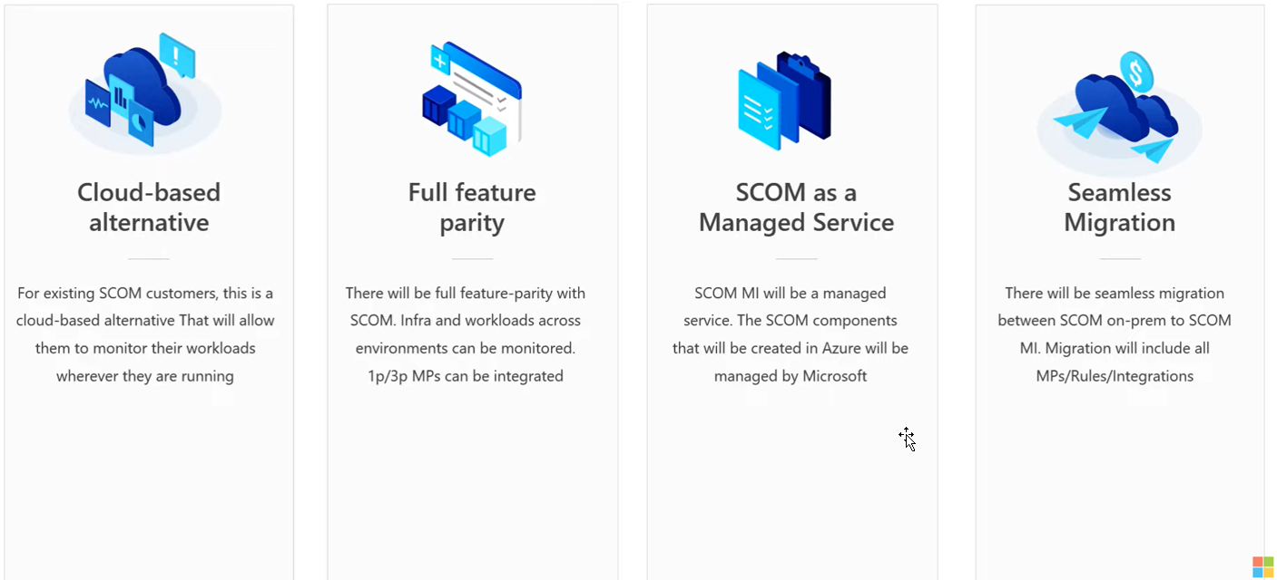
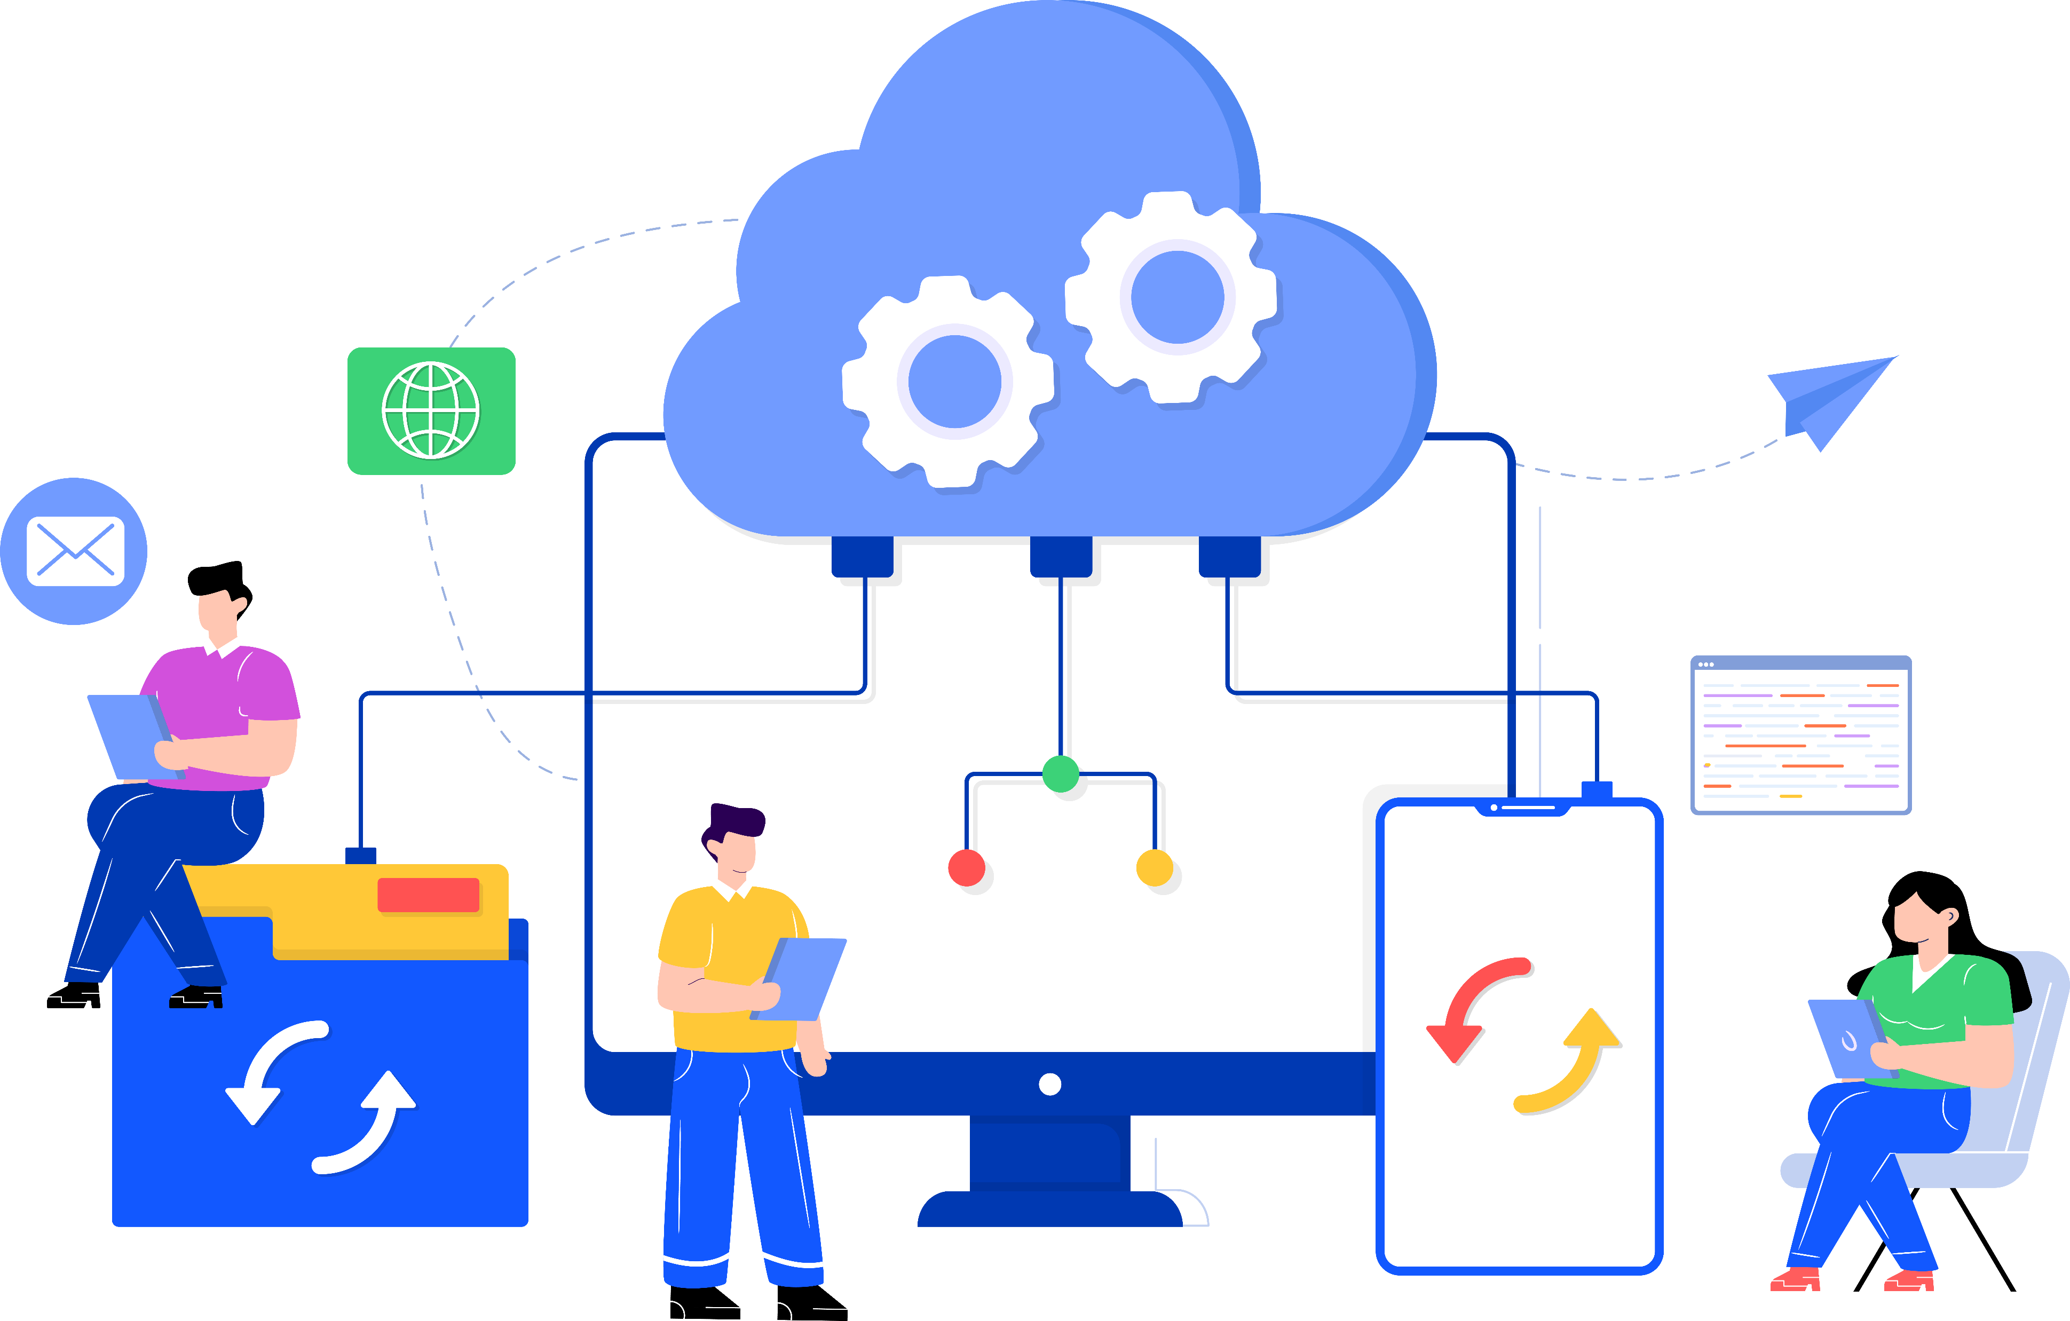
Azure Monitor SCOM Managed Instance
Notes:
Bringing SCOM MI as a capability of Azure Monitor, to go that step further when you need to have deeper insights into applications and solutions. Run from the cloud, it is a managed service.
What are some of the advantages of this method of working?

Slide 8
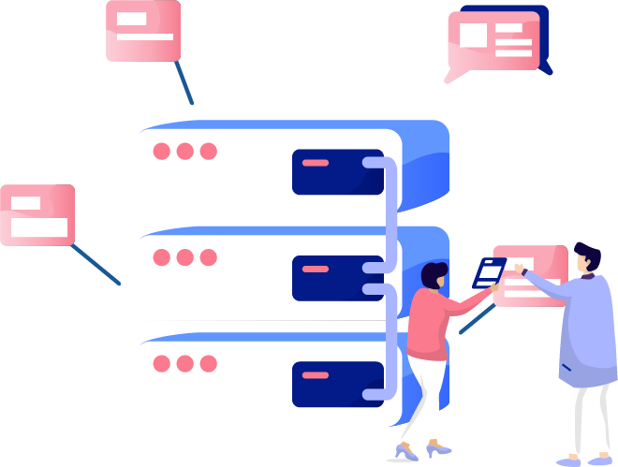
Advantages of SCOM MI
Setup/management on Azure
Zero DB maintenance due to offloading to SQL MI
Immediate and easy scaling
Quick and easy patching
Use existing management packs to monitor workloads
Connect using the "regular" SCOM Console
Views in PowerBI, Grafana, AzMon, SquaredUp or …
Notes:
Let’s take a few. *
Setup and management on Azure. *
We have no database maintenance because we use SQL managed instance for our backend. *
We can scale the SCOM management servers quickly with a few simple clicks and after the lunch they are there for you. *
Patching is clicking a button for the backend components. *
We use existing management packs for our workloads. *
We can use the same SCOM console to connect to it *
And we have views and insights through other tooling as well, such as PowerBI, Grafana, Azure Monitor, Squaredup and so on.

Slide 9
What is different/same?
Same:
Agents
~Gateways~
MPs
SCOM Console
Other UI
SQL MI
Mgmt servers
Different:
No SSRS
Reporting
Notes:
This brings us to what is different in SCOM MI. *
The most notable items here are that we moved the SQL to a SQL managed instance in Azure. We have management servers running in Azure and managed there. And SQL reporting services has been taken out. We will have to do our reporting insights in another way, through dashboarding and querying of data from another platform. We will discuss that later. *
Some things which are the same now.
We still have agents as we had before, and they connect to the management servers. Or through gateways. The existence of gateways is still here, but the story will change slightly. That’s why I have the wavy lines there. Management packs are the same thing and we can create overrides and so on in the same ways. We have the SCOM console as we had before. And we can make use of other ways to view SCOM data as well.

Slide 10
What do we need?
Connectivity On-Prem <-> Azure
Some On-Prem prerequisites
Some Azure prerequisites
And
Install SCOM MI
Do the important things (Agents and MPs)
Notes:
All right, now what do we need to get this thing to work? *
We need connectivity between our on-prem datacenter and Azure. The reason is that the SCOM management servers are domain-joined into the domain. Thus, we need network connectivity between the locations. *
We need some on-prem prerequisites as we will discuss in a minute. *
We need some Azure prerequisites, also following in the coming slides. And *
Then we install SCOM Managed instance * And do the important things, such as connecting agents up and doing the management pack work.

Slide 11
SCOM Managed Instance design sketch
NAT Gateway
Public IP
On-Prem and AD live here!
SCOM MI here!
VPN
VWAN
VNet 10.250.1.x /24
10.254.x.x
10.250.x.x
10.250.1.0/27
SQL MI here!
10.250.1.32/27
Notes:
Let’s start with the design and components of what we need. First the networking. We have on the left our on-prem datacenter with a subnet 10.254 /16. On the right we have the Azure cloud and we have decided to use 10.250 /16 there. We need to connect these two in some way. You can use express route or a VPN. We have made a VPN connection to the virtual WAN. *
We have to have a VNet there to host our SCOM MI stuff in and we are using a slash 24 network for that one. Within the VNet we create subnets. * One subnet for the SQL managed instance. * and a subnet where SCOM MI will be living with the management servers. * next, we apply a NAT gateway and assign a public IP to the SCOM MI subnet. This is used for outgoing traffic, such as getting new management packs. This is for now the networking piece of the story. In our test case, we are using the VPN just for this purpose, but in a hybrid or transition setup a company would have the networking stuff from Datacenter to Azure already figured out.

Slide 12
SCOM Managed Instance design sketch
AD Domain
NAT Gateway
Public IP
VPN
VWAN
VNet 10.250.1.x /24
10.250.1.29
10.254.x.x
10.250.x.x
10.250.1.0/27
User Account to create objects
Group for SCOM servers
GMSA account
DNS Entry SCOM Load Balancer SCOMmi.domain.local
10.250.1.32/27
Notes:
Now we move to the left side. On-prem prerequisites. We need to have an active directory sitting there. In cases where a business is running on-prem or hybrid, this is already in place. We need to get our management servers which live in the cloud into our active directory. We create a User account for that purpose in AD. This account has to be able to join a machine to the domain and * add the management server computer objects to a group. Meaning we need a group as well. What the group is used for is to give * access to the Group Managed service account that we create. Meaning, our SCOM management servers in Azure will be using a gmsa account as service account. * And finally, we need to create a DNS entry in our domain DNS zone pointing to an IP address in the SCOM MI subnet. This is for the load balancer which will appear there. We reserve it now. On-prem work done.

Slide 13
SCOM Managed Instance design sketch
AD Domain
NAT Gateway
Public IP
VPN
VWAN
VNet 10.250.1.x /24
10.250.1.29
10.254.x.x
10.250.x.x
10.250.1.0/27
User Account to create objects
Group for SCOM servers
GMSA account
DNS Entry SCOM Load Balancer
Key Vault
Managed Identity
SQL MI
10.250.1.32/27
Notes:
Now we move to the cloud side. * we create a managed identity. We can compare this to a service account. It is meant to give access to something. * We create a SQL managed instance through the wizard in the portal for that component and place it in the subnet we created. * We assign access to the SQL instance to the managed identity, which will be used by SCOM. * We also need a key vault to keep the username and password * of our on-prem user account. This way, the SCOM MI creation wizard can use it, but also subsequent updates to SCOM. This should take care of most our cloud prerequisites.

Slide 14
SCOM Managed Instance design sketch
AD Domain
NAT Gateway
Public IP
VPN
VWAN
LB
SCOM MI Mgmt server(s)
VNet 10.250.1.x /24
10.250.1.29
10.254.x.x
10.250.x.x
10.250.1.0/27
User Account to create objects
Group for SCOM servers
GMSA account
DNS Entry SCOM Load Balancer
Key Vault
Managed Identity
SQL MI
10.250.1.32/27
Notes:
Now, we run the SCOM MI installation wizard. * This will create a virtual machine scale set with one management server in it to start with. * and it will automatically create a load balancer in front of the management servers, and it gets assigned the IP address we reserved and used for the DNS entry earlier. This means we can reach SCOM through that DNS entry from agents or the SCOM console and it would figure out which management server it will use in the backend from the virtual machine scale set behind it. We now have an Azure Monitor SCOM Managed Instance.

Slide 15
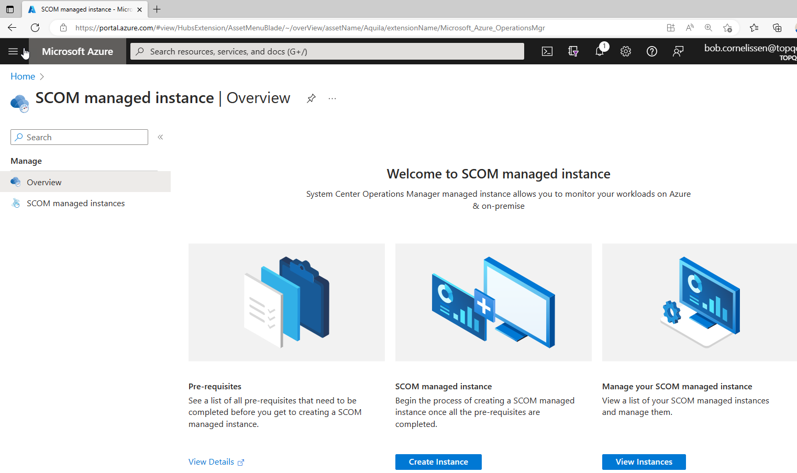
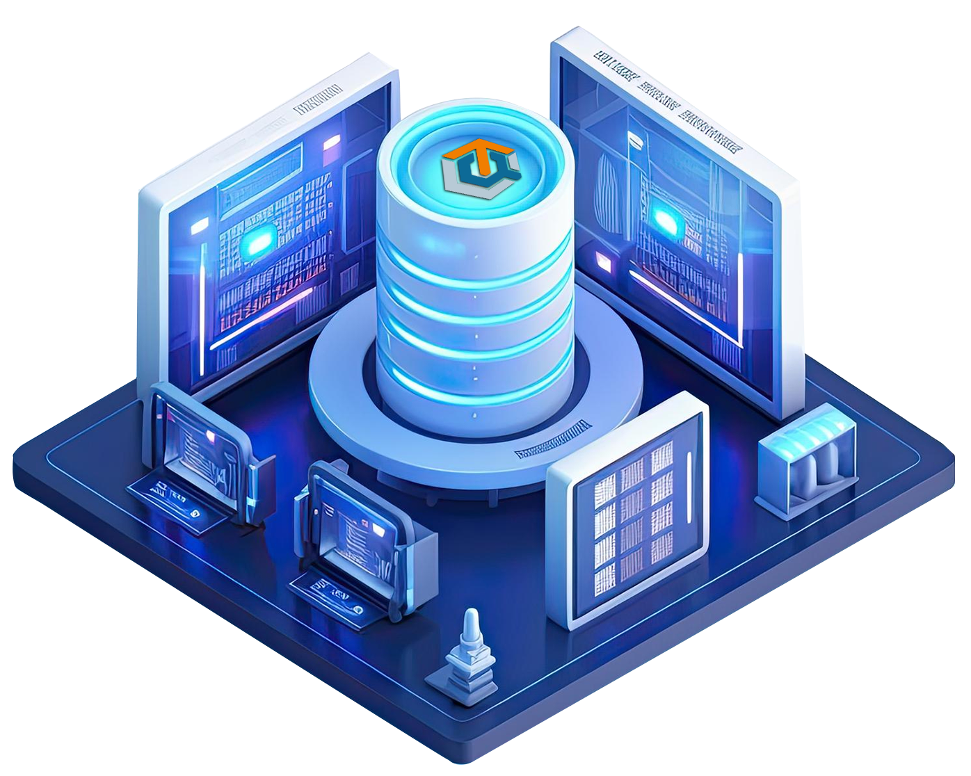
The Look
Notes:
What does this look like? When you start out with SCOM MI you have this overview from where you can work on doing the prerequisites work to create a new instance. You can create a new instance. And you can see existing SCOM instances you already have deployed.

Slide 16
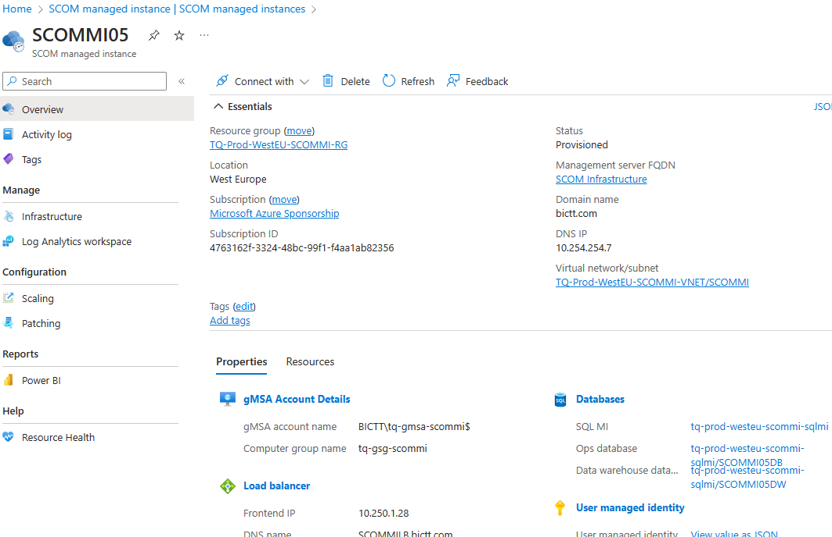
The Look
Notes:
Going to a specific SCOM instance we see an overview here with the most essential information. This was also needed during the install wizard phase. It contains network info, the service account, load balancer, SQL data and so on. This is the place where we can also do things like scaling and patching and so forth.

Slide 17
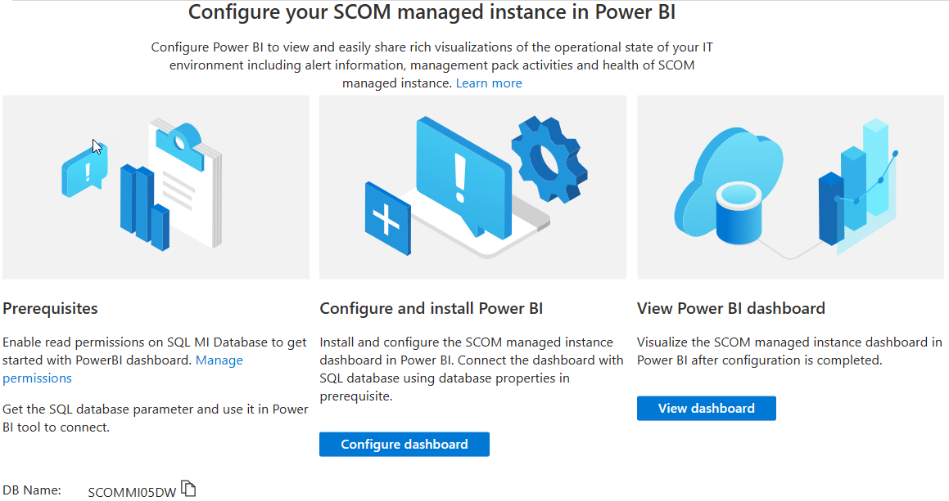
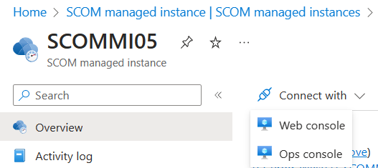
Next steps 1 – The visuals
Connect SCOM Console
Install Web dashboarding
PowerBi
Notes:
Now that we have a base install, we have to get started with it. Let’s connect to it. * From the second picture you see a Connect With dropdown option and it gives options to download the SCOM console or Web console bits and you can install them on your machine somewhere. The SCOM console will be first. You can do all that you could previously do in that console, except the reporting pane. * There is currently also an option to configure and view a PowerBI dashboard with a few views giving insights into some pieces of your SCOM deployment.

Slide 18
Visuals
SCOM Console (+ web)
PowerBI
Log Analytics – Workbooks
Grafana
Third-party dashboarding
Notes:
Today, we have the set we just mentioned, the SCOM console, the web console, and PowerBI. Right now, also the Log Analytics connection is created, whereby we can send data into a Workspace. From there we can use KQL queries and workbooks to talk to the data and view and analyze it. I will talk briefly about this in a bit.
Next, coming soon as mentioned by Ankur earlier is Grafana dashboarding connected to the data in SCOM for dashboarding.
And of course, we can still connect existing third-party dashboarding tools which are currently talking to the normal SCOM also to this SCOM.

Slide 19
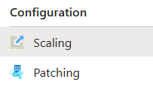
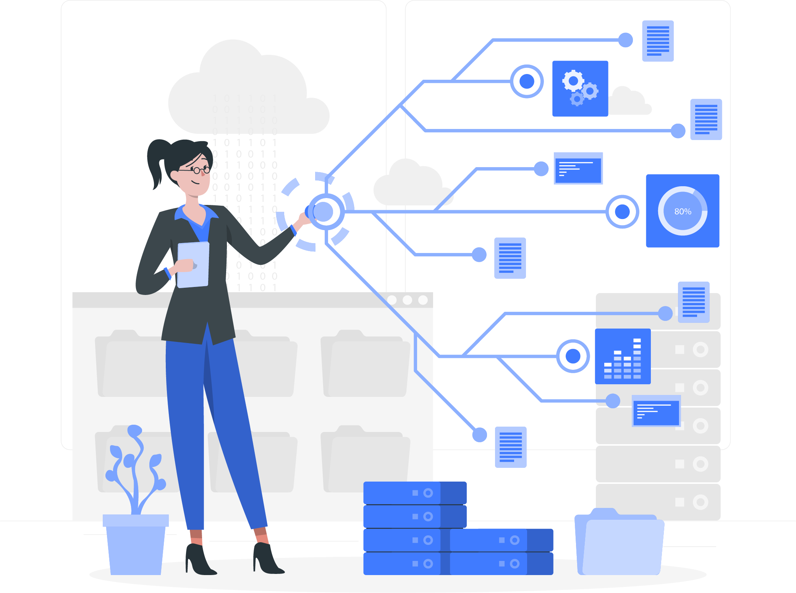
Next steps 2 - Agents
Scale SCOM MI
Gateways to connect up (optional)
Agents to connect up
Notes:
Now, we need to get ready for our agents. *
First, we scale SCOM by using the Scaling option. It will ask you how many agents you have or expect and based on that information it will create the required number of management servers in the scale set. *
We can use gateways to help in the communication between agents and the management server if we need that. The gateway story will be slightly adjusted from what we are formerly used to. The team is working on the gateway story in SCOM MI, and we hope to do some testing with them in a few days or weeks. I can not tell you more about this right now. * And of course, we get agents to connect up to our SCOM MI. Either directly or through a gateway. In the end, we point them at the load balancer DNS entry for SCOM managed instance. While we are on the picture to the right there; you can also see the Patching menu option, which leads you to the place where you can deploy an update to the SCOM backend, when it is available. If you deploy a fresh instance, it will already be patched to the latest version. The patching procedure is very simple, by clicking a button and waiting an hour while the backend does the work for you.

Slide 20
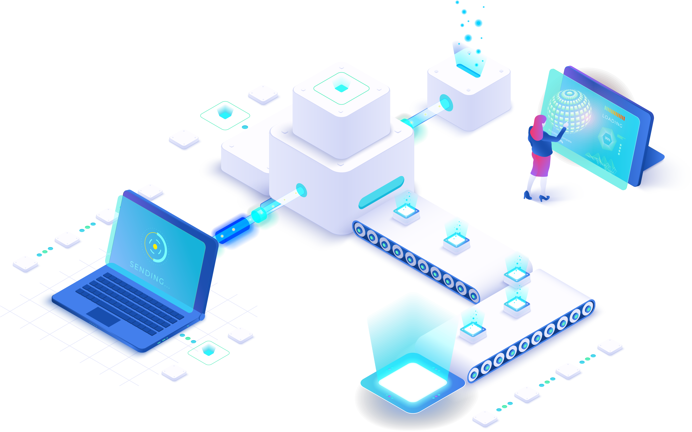
Next steps 3 – Management Packs
Load Management Packs
Load more packs
1
3
Create custom packs
Tune and Override
2
4
Notes:
This brings us to the management packs. We start loading some base management packs, such as Windows Server, SQL, IIS, Active Directory and such. * We tune and override what we need - or we take the existing tuning from our on-prem SCOM and apply it here. * Next, we load more packs. * And we can look into the custom packs to load or create for our business applications and so on.

Slide 21
So, do Management packs still work?
Notes:
One of the big questions we get asked is whether the existing management packs still work. The good news is that * as far as we all can tell, they work. The SCOM engine is still the same. I can imagine that you might run some Linux or Network monitoring through a gateway instead of from the management servers in the new setup. But that does not change the management packs themselves.

Slide 22
What’s new?
?
Notes:
This brings me to a few items in SCOM MI which are relatively new. I am talking weeks or days.

Slide 23
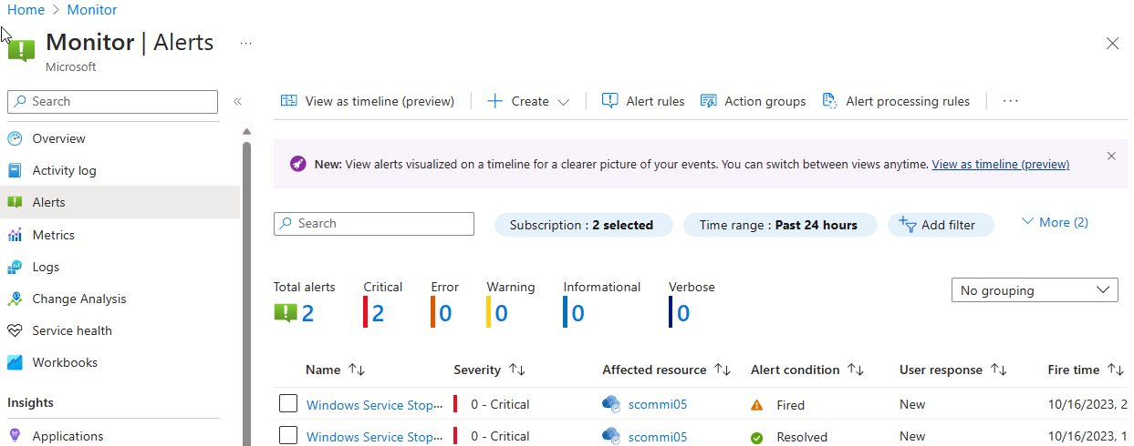
Azure Monitor Alerts
Notes:
Starting with Alerts in Azure Monitor. If you have a running SOCM managed instance and you have a few alerts in there, or had a few that are closed by now, you can look at Azure Monitor. On the left, you find the Alerts section. In the middle you see time range in blue to adjust to for example a few days. And another filter is there where you can show either active alerts or also the closed alerts by selecting Fired or Resolved as Alert condition. This gives you a list of alerts.

Slide 24
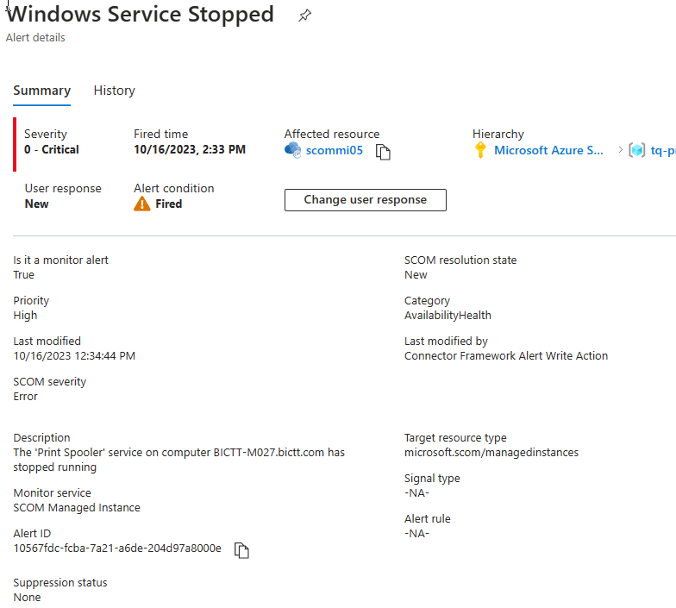
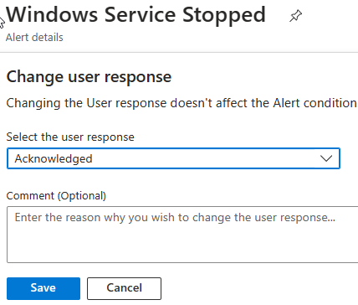
Windows service stopped
Notes:
When you open up an alert, it looks a bit like this. It gives the essential information from the alert as it came from SCOM Managed Instance, with time and date, resolution state, whether it came from a monitor or rule, severity, category, description and a few more. Near the top you see a change user response button * and if you click it, you can add a user response to for example acknowledge it here and put in a comment. Now, at this moment, it does not yet write back to SCOM MI, but it might be on the wish list.

Slide 25
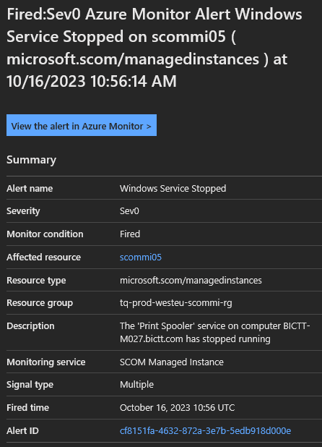
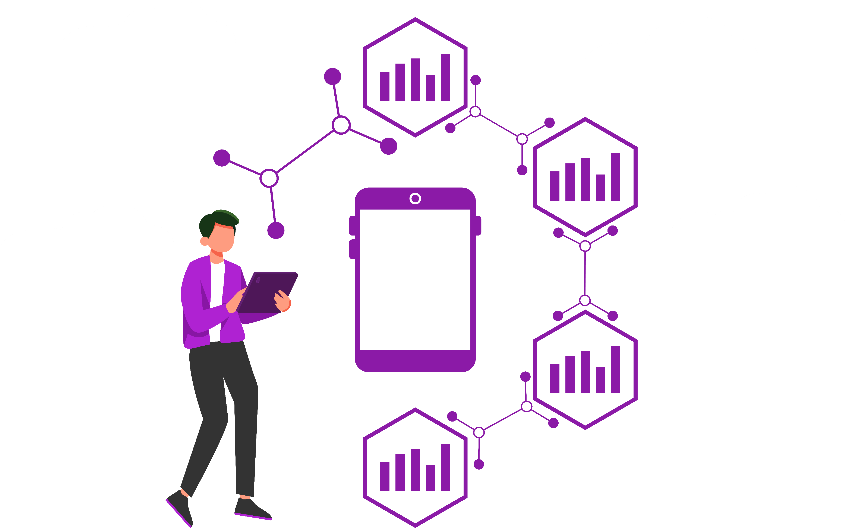
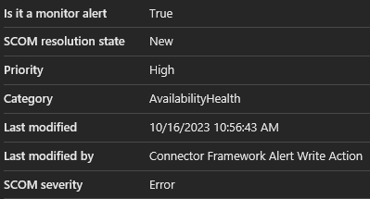
Alert
rules
Notes:
What we can also do from the alerts list is to create Alert processing rules, Alert rules and Action groups to react to incoming alerts. In this case, I just went ahead and created something to send me an email if an alert comes in with a severity 0, 1, or 2. * which results in an email in my mailbox with this information.
We were talking about SCOM MI a few months ago and the vision for the near future, whereby we see more and more integration between SCOM MI and Azure Monitor. This was a starting point for that.

Slide 26
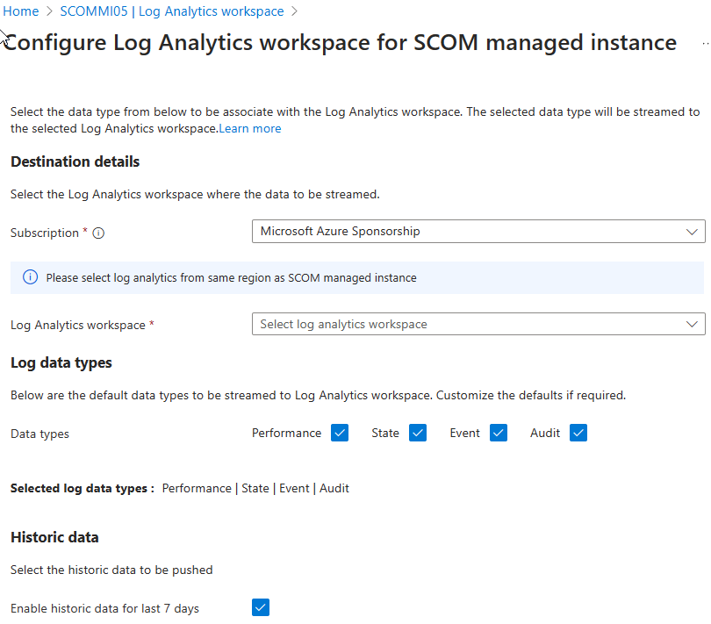
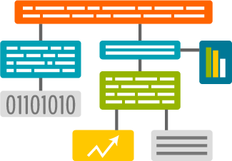
Log Analytics
KQL
Workbooks
Alerting
Notes:
Next, since a few days, we have the possibility to connect the SCOM MI instance to Log Analytics. You click a button, and you get a wizard shown here. You select a subscription and an existing workspace to connect to. We select the data types we want to see in Log Analytics and if we want to add some historic data to this.

Slide 27
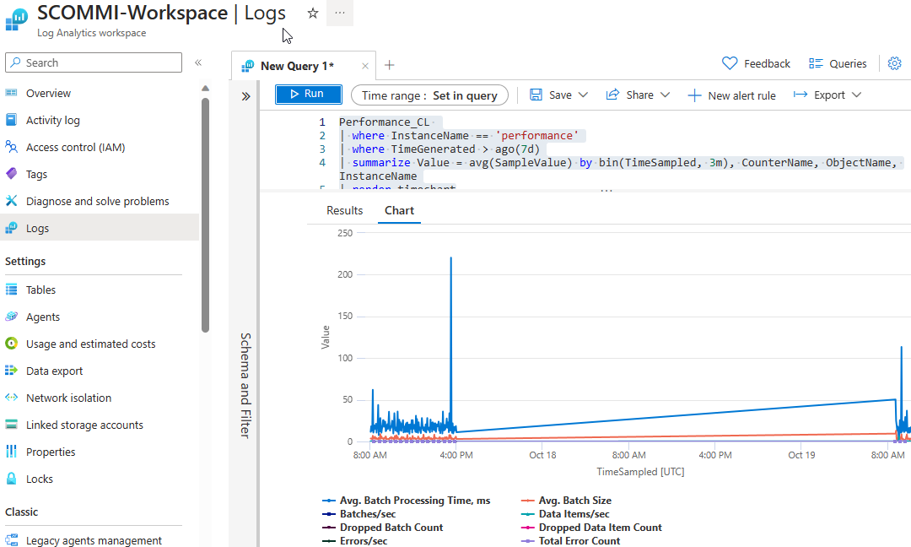
Notes:
And we get some tables added in log analytics, that we can query for data. This is just a bit of performance data to check that something was coming in.
From here, the next steps will be workbooks and useful queries and so on.

Slide 28
Soon
Gateways
Migration Accelerator
Grafana dashboards
Notes:
Coming soon in this story…. *
We mentioned the gateways story. The product team is working on this and I am sure we will be able to test this soon. As long as it is not there and visible, I can not comment on NDA content in public. *
We have seen in Ankurs presentation there will be a migration accelerator to bring your configuration across in some way. * And there is work underway to look into creating Grafana dashboards using an Azure hosted Grafana instance.

Slide 29
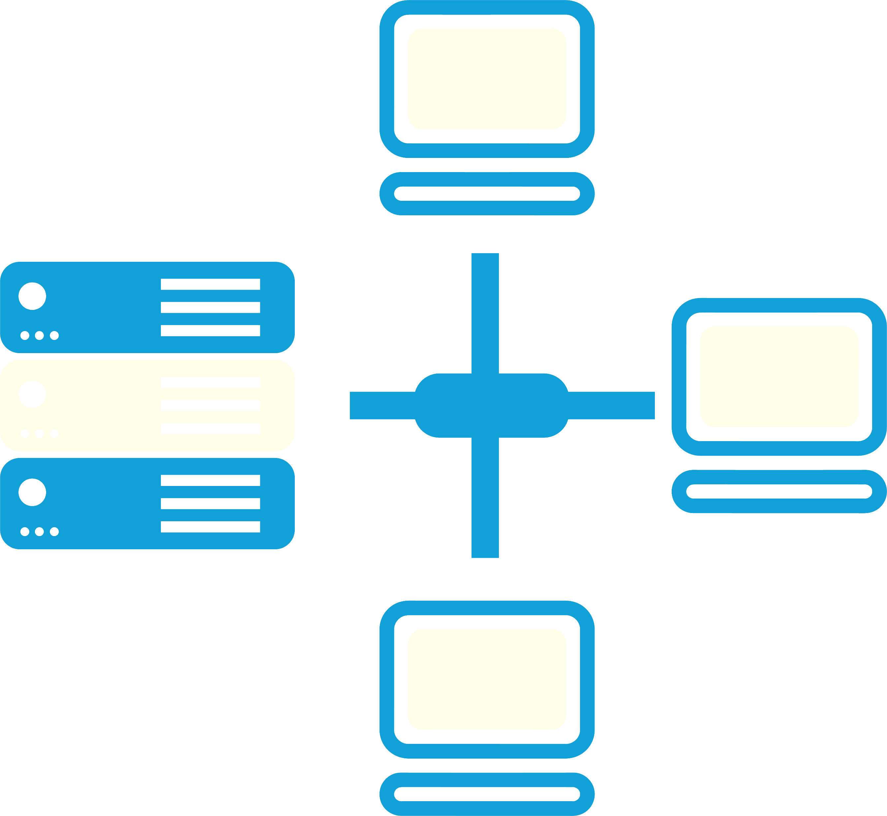
Future
Currently Public Preview
Adjustments made
GA soon
Continuous updates
Azure Monitor, Azure Portal
Authentication & Management
Dashboarding
Notes:
Looking out to the future… *
We are currently in public preview with adjustments made regularly to add the pieces the product team wants. * with an expected GA date somewhere soon. A month has been mentioned earlier as the target. * We seen continuous updates coming out. * we see more and more integration with Azure Monitor and the Azure Portal as expected. * Work being done on Authentication and management of SCOM and * dashboarding is underway.

Slide 30
Questions?
contact@topqore.com

