Slide 1




MP UNIVERSITY
THURSDAY OCTOBER 19

Slide 2
Logistics
Problems? Email info@silect.com
We want your questions! Please use the Q&A window to interact with the speaker
Survey: please complete the survey which will be sent after webinar has finished
Sessions are being recorded and links will be sent out to everyone who registered

Slide 3
MP University Agenda
Time (EDT) | Session Title | Presenter
8:00 | Introductions & Kick-off | Silect
8:10 – 8:55 | SCOM Managed Instance GA & Beyond | Ankur Gupta Microsoft
8:55 – 9:35 | Management Pack Authoring Tools and Techniques | Mike Sargent Silect
9:45 – 10:30 | Inside SCOM Managed Instance | Bob Cornelissen Topqore
10:30 – 11:00 | Self-Service and Automation | Harold Dyck & Mike Sargent Silect
11:10 – 11:55 | SCOM Management Pack Development with AI and GitHub Copilot | Vincent de Vries, Jonas Lenntun Opslogix
11:55 – 12:40 | Keeping Your SCOM Deployment Healthy | Kevin Holman Microsoft
12:40 – Close | Open SCOM Q&A | Kevin Holman Bob Cornelissen Mike Sargent

Slide 4

Keeping SCOM Healthy
Common issues still found in the field
Best Practices to avoid them
Tools to monitor for them

Slide 5
SCOM Data Collector
https://aka.ms/SCOM-DataCollector
Collects SQL queries
Event Logs
General information
DEMO
https://blakedrumm.com/blog/scom-data-collector/

Slide 6

Database Sizing
OperationsManager
Presize this with LOTS of free space
Don’t use AutoGrow on the DB file
Set log to 50% of the DB size (simple)
Set log to 3x the DB size (full) with autogrow limited to 80% of the volume size with 500MB per growth
https://kevinholman.com/2022/05/01/scom-2022-quickstart-deployment-guide/

Slide 7
Database Sizing
OperationsManagerDW
Presize this with LOTS of free space
DO use AutoGrow, Limit to 80% of the volume size, Growths set to 1000MB for DB file and 500MB for log
Set initial log to 10% of the DB size

Slide 8
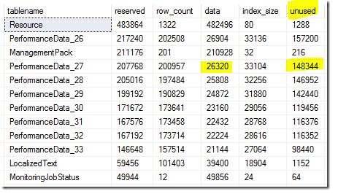
Daily Reindex
Bulk Insert Issue
Daily is recommended
Ops DB Only
SQL 2016 and later
https://kevinholman.com/2017/08/03/what-sql-maintenance-should-i-perform-on-my-scom-2016-databases/

Slide 9
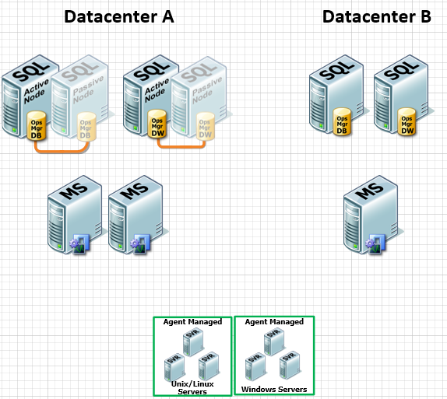
Management Server Locations
Latency is a killer
DR scenarios
5-10ms latency
Resource pool planning
Designing SCOM for Disasters - YouTube

Slide 10
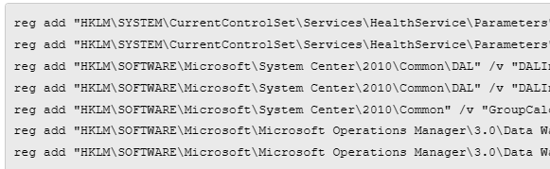
Registry not optimized
Critical
Database reconnect
Scale
DW timeouts
Group Calc
Recommended registry tweaks for SCOM 2016, 2019, and 2022 management servers - Kevin Holman's Blog

Slide 11

Over-permissioned Service Accounts
Risk of compromise
No Domain Admin
No rights on Agents
No Sysadmin to SQL

Slide 12
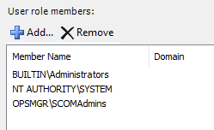
SCOM Admins Security
BUILTIN\Administrators
Too many cooks in the kitchen

Slide 13

Event Logs
Left at Default Sizing
MS and GW roles
Too small
Set to 60 – 100 MB

Slide 14

Agent Proxy Default
Enable this
Avoid MP failure
Noise
Set and forget
Enable proxy as a default setting in SCOM - Kevin Holman's Blog

Slide 15

SCOM License Key Not Set
Avoid 180-day timeout
Don’t forget to License your SCOM 2016 deployments - Kevin Holman's Blog

Slide 16
Agents Installed on Management Server
HealthService restarts
Memory issues
Often by accident

Slide 17
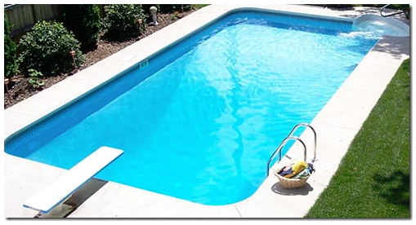
Resource Pools not Optimized
DR scenarios
Large environments
Understanding SCOM Resource Pools - Kevin Holman's Blog

Slide 18

Noise and Bloat
Alerts
Events
Performance
State Changes
Too many instances
Tuning tip – turning off some over-collection of events - Kevin Holman's Blog
Tuning tip: Do you have monitors constantly “flip flopping” or a lot of old statechange events? - Kevin Holman's Blog

Slide 19
DW Retention not set
Default settings are not right for you!
Set for your SLA
Reduce cost and recovery
Understanding and modifying Data Warehouse retention and grooming - Kevin Holman's Blog
System Center Operations Manager - Data Warehouse Grooming Tool | Blake Drumm - Technical Blog

Slide 20
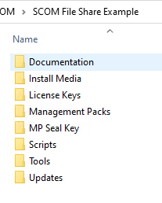
SCOM File Share
A SINGLE location for all your SCOM files
Documentation
Install Media
License Keys
Management Packs
MP Seal Key
Scripts
Tools
Updates

Slide 21
SCOM Health Management pack
Monitors for key health scenarios
DB Sizing
Registry key optimizations
Licensed status
Agent Proxy
DW Retention
Event Log sizing
Agent on MS
Resource pool observers

Slide 22
SCOM Health Management pack
Rules
Config File Agent on Agents
HealthService Store Size collection
Tasks
Offline Defrag Health Service Store on Agents

Slide 23
SCOM Health Management pack
Recovery Tasks
Set all recommended Reg Keys
Fix event log sizes
DEMO

Slide 24
SCOM Health Management pack
Available NOW for download:
https://github.com/thekevinholman/SCOM.Health

